Slide 1
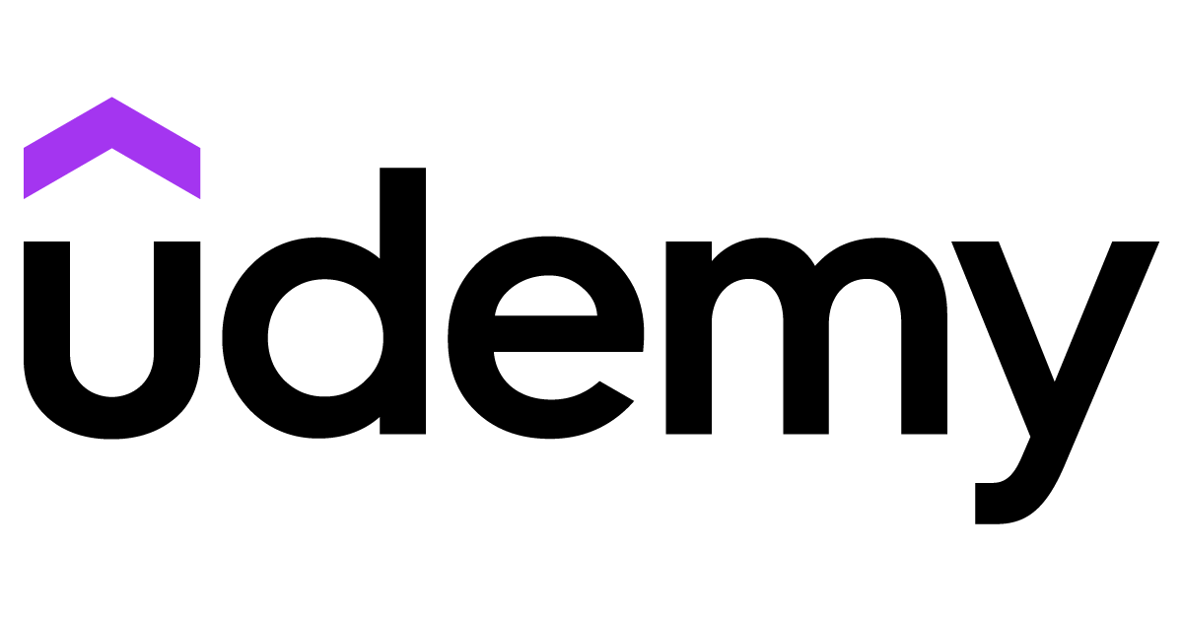
Predicting the Number of Subscriber for 10k Development Courses
Reem Bin Obaidan

Slide 2
INTRODUCTION
The last few years have seen an upward growth in the popularity of e-learning and e-learning methods. This has been possible due to our dependency on the digital lifestyle and the cost-effectiveness of the plans.
World had come face-to-face with the pandemic of Covid-19, the growth of e-learning has increased tenfold. From students to professionals, everyone is using digital mediums to add new skills to their knowledge .

Slide 3



Analyzing & Visualization
What are the most popular courses?
What courses offer the best cost benefit?
What are the most engaging courses?

Slide 4
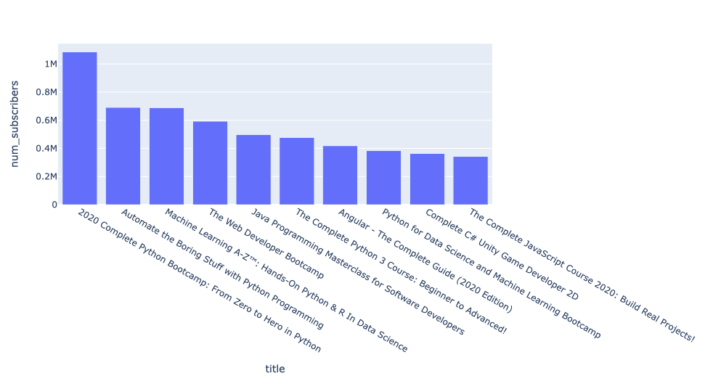
Most Popular Courses

Slide 5
Best Cost Benefit
cost_benefit =
course price <=average course price
And number of subscriber >= average number of subscriber
The course which offers the best cost benefit is:
Automate the Boring Stuff with Python Programming
Learn HTML5 Programming From Scratch
Python for Absolute Beginners
Data Analysis with Pandas and Python
Learn Ruby on Rails from Scratch

Slide 6
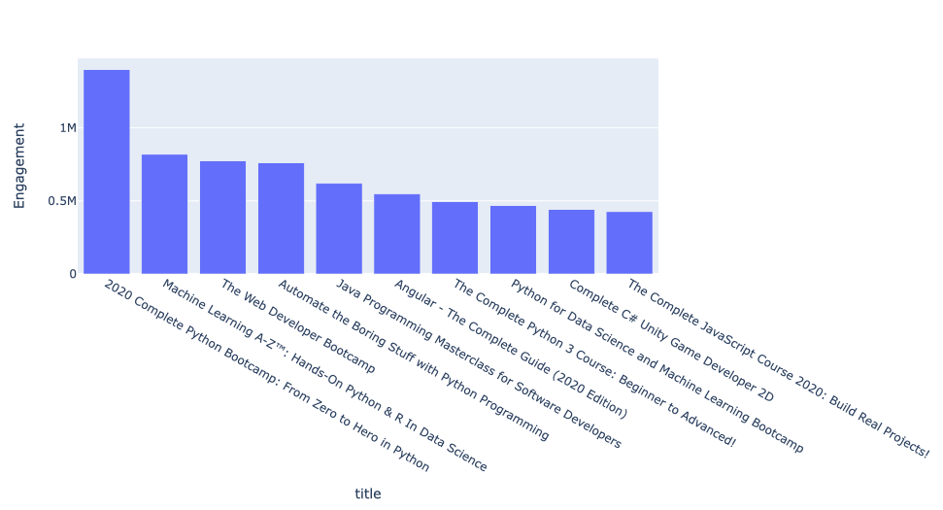
Engaging Courses
Total engagement = number of subscribers
+ number of reviews.

Slide 7
Predictive Analysis
Regression models :
To:
Everyone
More
Support Vector Regression
Linear Regression
Random Forest Regressor
Kernel Ridge Regression
Gradient Boosting Regression
Elastic Net Regression
Type message here...

Slide 8
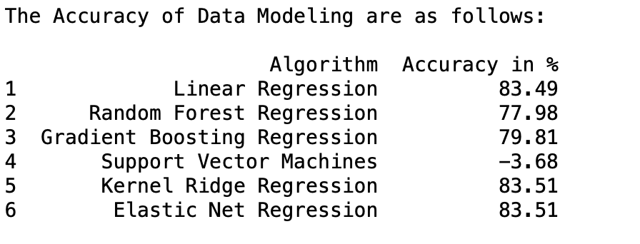
Conclusion

Slide 9
Thank you !

